Slide 1

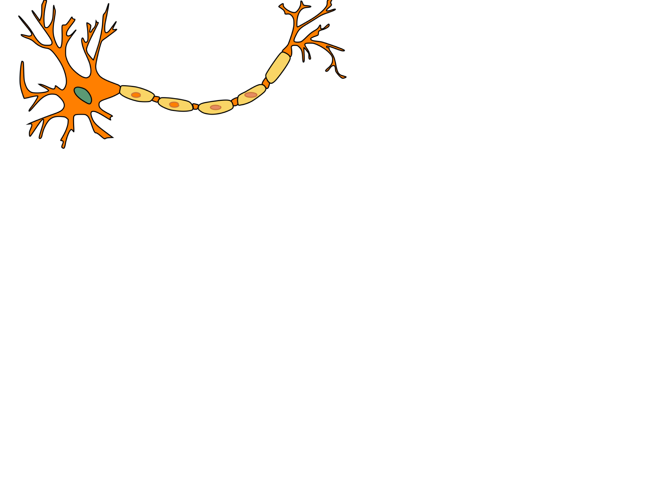
Project Logic Brain : a Binary Neural Networks acceleration
Presented by:
Alexandre Riviello
Nathan Heraief
Mohammad Hossein Askari

Slide 2
Introduction
Context:
Goal: Accelerate a neural network inspired algorithm using a hardware/software solution.
The SocKit board must be used.
Two potential situations: A 5 minute case and a 24 hour case.

Slide 3
Presentation Plan
Structure:
Architecture and features
NeuralCore
Memory Management
Controller Unit
Simulation and Verification
Test benches & scripts
Sniffer module
Results, specifications, problems & improvements
Conclusion

Slide 4
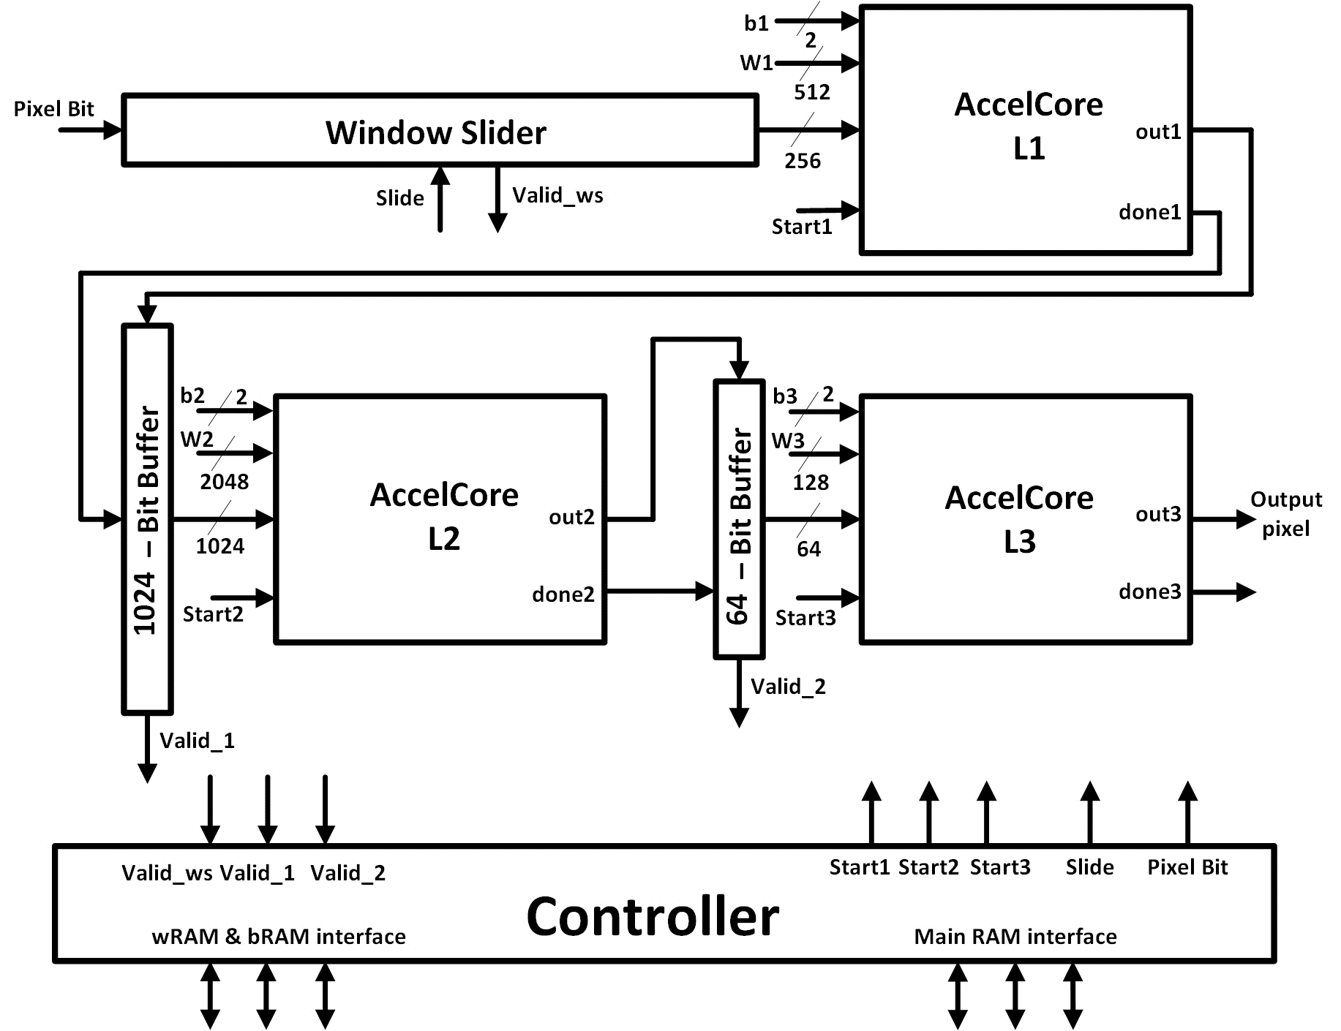
1. Architecture and Features
Full Architecture:
Window Slider
3x AccelCore
3x Bit Buffer
Controller
Memory

Slide 5
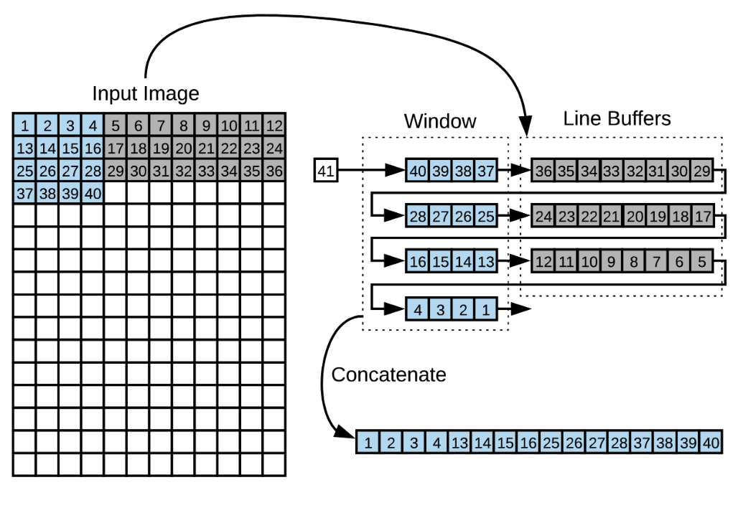
1. Architecture and Features
NeuralCore (Window Slider):
Inspired by Farabet, C., Poulet, C., Han, J. Y., & LeCun, Y. (2009, August). Cnp: An fpga-based processor for convolutional networks. In Field Programmable Logic and Applications, 2009. FPL 2009. International Conference on (pp. 32-37). IEEE.

Slide 6
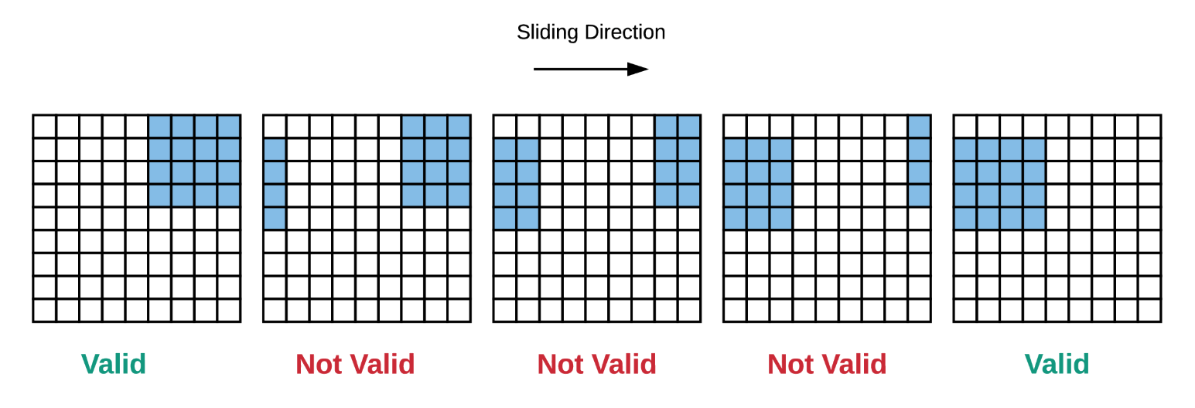
1. Architecture and Features
NeuralCore (Window Slider – part 2):

Slide 7
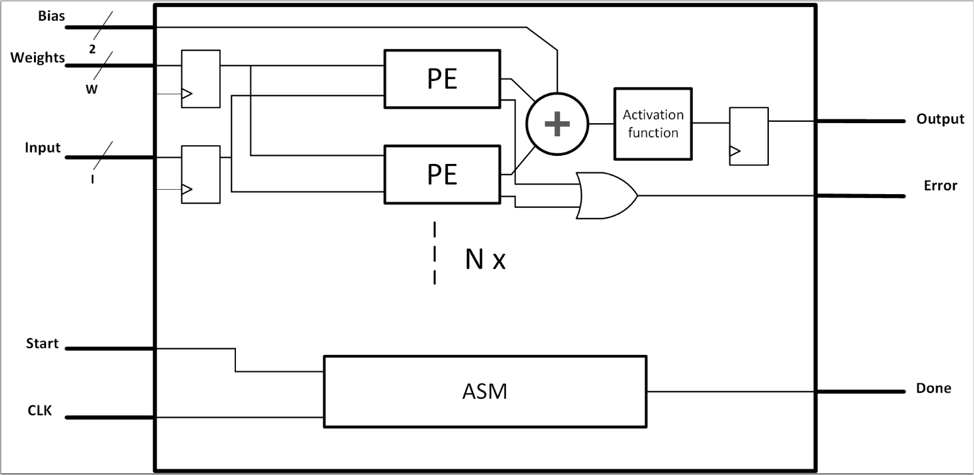
1. Architecture and Features
NeuralCore (AccelCore):

Slide 8
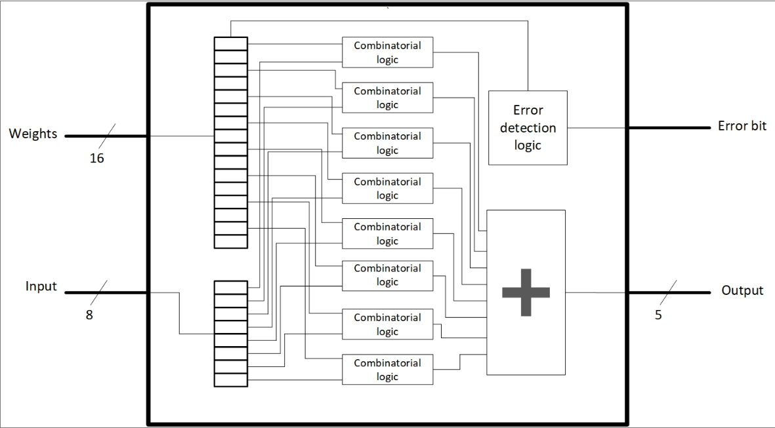
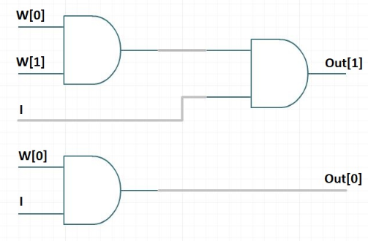
1. Architecture and Features
NeuralCore (AccelCore – part 2):

Slide 9
1. Architecture and Features
Memory Management:
https://www.intel.com/content/www/us/en/programmable/quartushelp/13.1/mergedProjects/reference/glossary/def_m10k.htm

Slide 10
1. Architecture and Features
Controller Unit:
Controller waits for 3 signals (valid_ws, valid_1 and valid_2)
Once these signals are high, it reads all the RAM addresses consecutively within a same layer.

Slide 11
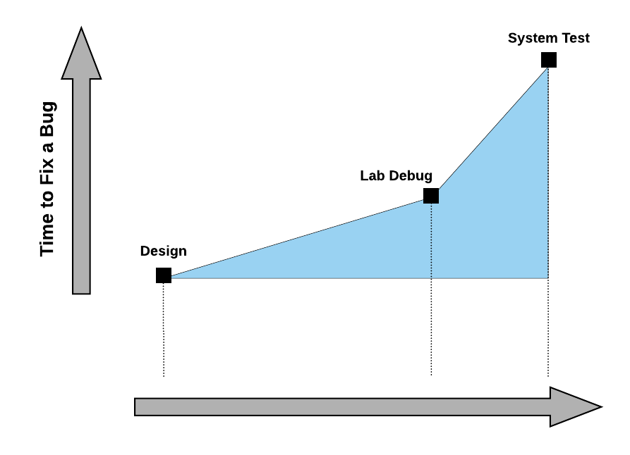
2.Simulation and Verification
Cost (time and money) of fixing a bug over time (image from internsix)

Slide 12
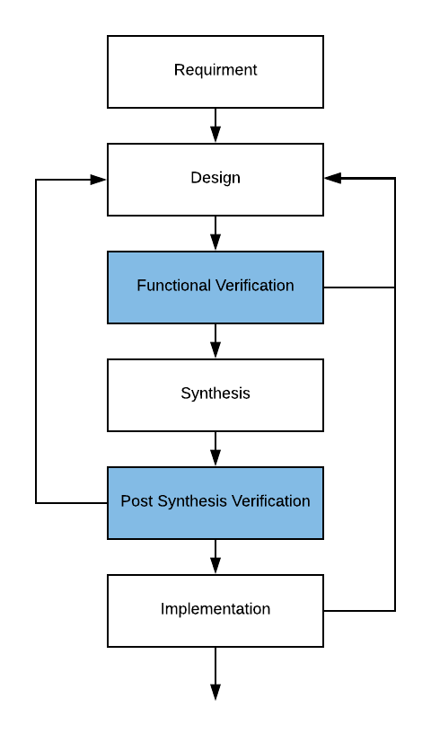
2.Simulation and Verification
Verification and validation in FPGA design is a crucial step.
We splitted the verification into following steps:
Writing test bench for every module (unit test)
Writing System level test bench to verify the integration
Writing software models to test the simulation results

Slide 13
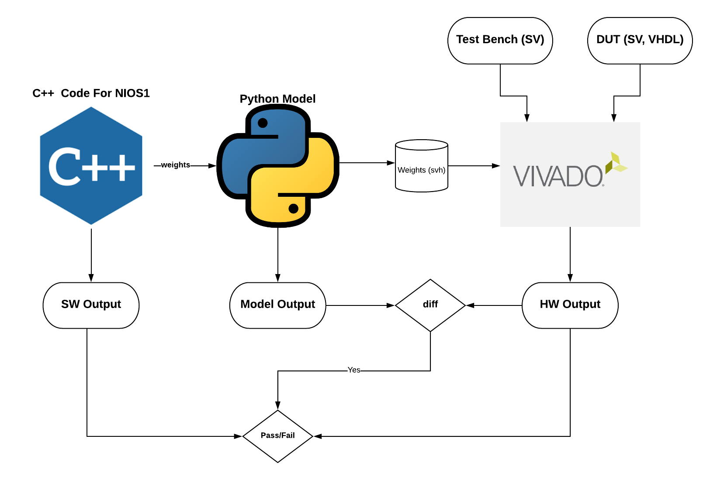
2.Simulation and Verification
Verification of Neural Core

Slide 14
2.Simulation and Verification
We did a lot of scripting and simulation!
Window Slider
Accel Core
Neural Core
VGA output displayer
Test and Simulation harness around Vivado
Python model
Python model

Slide 15
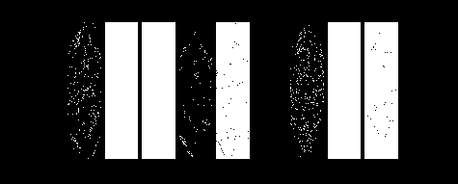
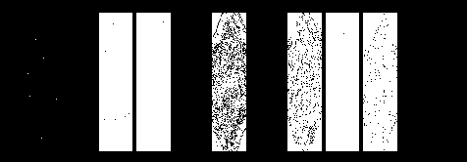
2.Simulation and Verification
Our Software model generates exactly the same output!
40 x 40 x 10
1024 x 60 x 10

Slide 16
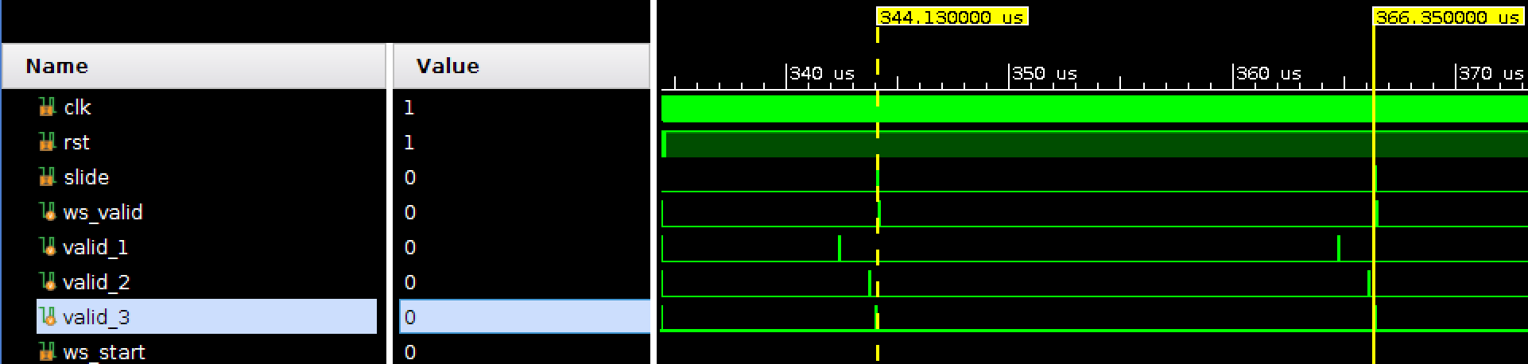
2.Simulation and Verification
Our simulation shows that we can produce 8325 (184*45) pixels in 185ms @ 50MHz (22us per output)

Slide 17
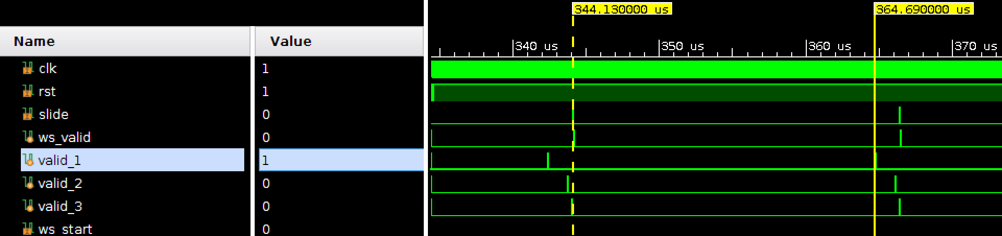
2.Simulation and Verification
By adding a pipeline in window slider we can achieve around 10% boost

Slide 18
2.Simulation and Verification
Demo!

Slide 19
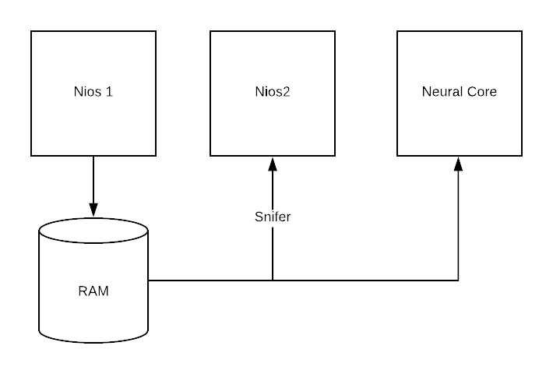
2.Simulation and Verification
For validation, we used the second Nios as a packet Sniffer to report all transaction to the ram. This helped us to know what values are being written to the RAM module

Slide 20
3.Results/Specs/Problems & Solution
1. Results
Reference result
Our result

Slide 21
3.Results/Specs/Problems & Solution
2. Specs : Timing
Time to load weights and bias:
Time to calculate worst scenario :
335ms
256ms

Slide 22
3.Results/Specs/Problems & Solution
2. Specs : Resource consumed
Logic utilization (in ALMs) :
15,707 / 41,910 => ( 37 % )
Total registers :
23762
Total block memory bits :
3,472,880 / 5,662,720 => ( 61 %)
Total RAM Blocks :
459 / 553 => ( 83 % )
Notes:
Total pins : 252 / 499 ( 51 % )
Total DSP Blocks : 9 / 112 ( 8 % )
Total HSSI RX PCSs : 0 / 9 ( 0 % )
Total HSSI PMA RX Deserializers : 0 / 9 ( 0 % ) Total HSSI TX PCSs : 0 / 9 ( 0 % )
Total HSSI PMA TX Serializers : 0 / 9 ( 0 % )
Total PLLs : 2 / 15 ( 13 % ) Total DLLs : 2 / 4 ( 50 % )
Total virtual pins : 0

Slide 23
3.Results/Specs/Problems & Solution
3. Problems and Solution
Problem
Solution
Implementation
Zero Padding the input to max size (200x60)
Input can have different size
Preprocess the input
Flip all line buffers in neural core
Image is flipped
Check MSBs and LSBs

Slide 24
3.Results/Specs/Problems & Solution
4. Futur Improvements
Pipelining the Neural Core => 10%
And ?

Slide 25
4. Conclusion
Because figures are better than words :
2k times faster

